Slide 1

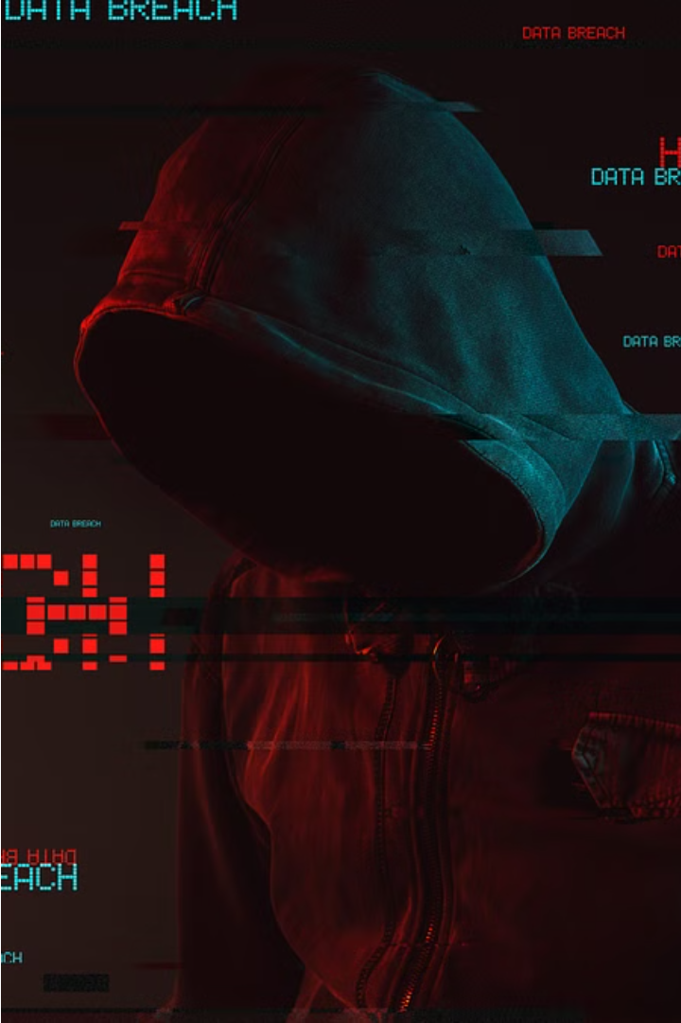

Uber Data Breach: A Cybersecurity Nightmare
The Uber data breach exposed the vulnerabilities of even the largest companies to sophisticated cyber attacks. This cautionary tale underscores the importance of robust cybersecurity measures in an increasingly digital world.

Slide 2
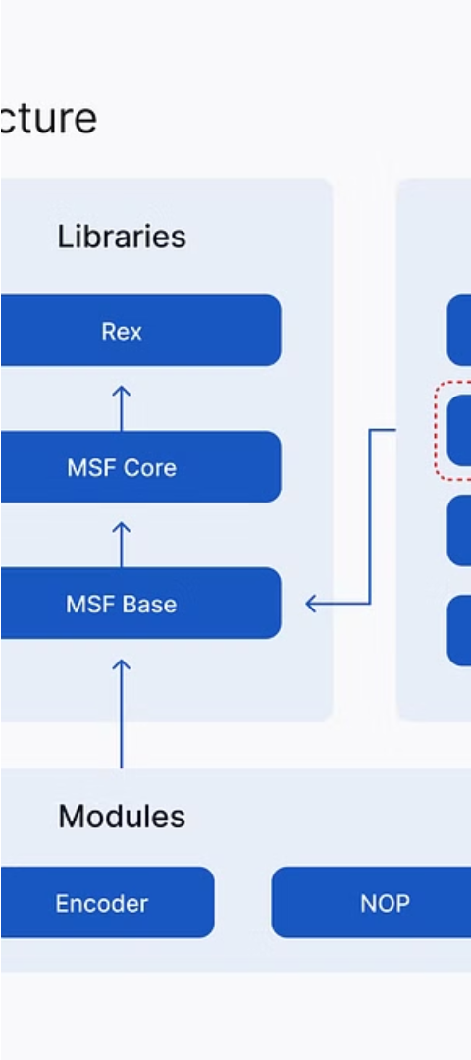
Metasploit: The Hacker's Toolkit
1
Penetration Testing
2
Automated Attacks
Metasploit is a powerful framework used by security professionals to identify and exploit vulnerabilities in systems.
Metasploit can execute automated attacks, streamlining the process of discovering and exploiting weaknesses.
3
Evasion Techniques
Metasploit offers advanced evasion techniques to bypass security measures and maintain access to compromised systems.

Slide 3
Shodan: The Search Engine for the Internet of Things
Internet Surveillance
Device Enumeration
Threat Identification
Shodan is a search engine that allows users to find and identify internet-connected devices, including those with vulnerabilities.
Shodan can provide detailed information about the make, model, and configuration of connected devices, aiding in targeted attacks.
By scanning the internet, Shodan can help cybersecurity professionals and researchers identify emerging threats and vulnerabilities.

Slide 4
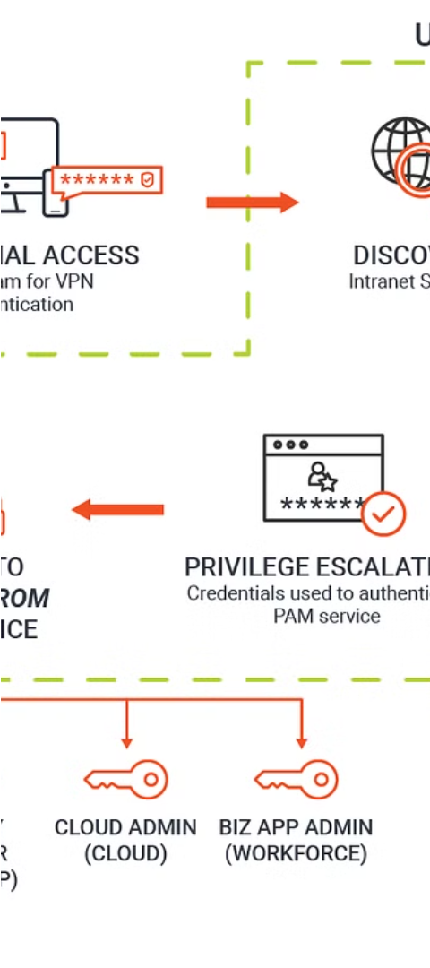
The Uber Breach: A Timeline of Events
1
Initial Compromise
Hackers gained access to Uber's systems through an AWS credential exposed in a GitHub repository.
2
Data Exfiltration
The attackers stole sensitive data, including personal information of over 57 million Uber users and drivers.
3
Disclosure Delay
Uber delayed disclosing the breach for over a year, leading to a $148 million settlement with US regulators.

Slide 5




Securing the Internet of Things
Strong Passwords
Regular Updates
Network Segmentation
Continuous Monitoring
Enforce the use of complex, unique passwords for all IoT devices to prevent unauthorized access.
Keep IoT device firmware and software up-to-date to patch known vulnerabilities.
Isolate IoT devices from the primary network to limit the impact of potential breaches.
Implement security monitoring to detect and respond to suspicious activity on IoT devices.

Slide 6




Mitigating the Shodan Threat
Visibility
Identify and inventory all internet-connected devices within your organization.
Vulnerability Assessment
Assess the security posture of your devices and identify potential entry points.
Remediation
Patch vulnerabilities, update default credentials, and implement network segmentation to reduce the attack surface.

Slide 7
Lessons Learned from the Uber Breach
Incident Response
Third-Party Risk Management
Establish a comprehensive incident response plan to ensure timely detection, containment, and remediation of security incidents.
Thoroughly vet the security practices of third-party vendors and contractors with access to sensitive data.
Transparency
Cybersecurity Investment
Promote a culture of transparency and accountability to ensure prompt disclosure of security breaches to impacted parties.
Prioritize cybersecurity as a critical business function and allocate sufficient resources to protect against evolving threats.

Slide 8
The Rise of Offensive Security Tools
Metasploit
A powerful open-source framework for penetration testing and exploitation
Shodan
A search engine that indexes internet-connected devices, exposing potential vulnerabilities
Kali Linux
A Linux distribution focused on advanced penetration testing and security assessment
OSINT Tools
Open-source intelligence tools that gather data from the internet to support security analysis

Slide 9
Securing the Future: A Proactive Approach
Continuous Monitoring
Employee Training
Emerging Technologies
Implement robust security monitoring solutions to detect and respond to threats in real-time.
Educate employees on cybersecurity best practices to reduce the risk of human-related incidents.
Leverage advanced technologies like AI and machine learning to strengthen security and stay ahead of attackers.

Slide 10

P.NIRANJAN REDDY
RA2111030010177
Notes:
P. Niranjan Reddy Student ID RA2111030010177.

